Slide 2
TIROCINIO
STAGE
INTERNSHIP
TRAINEESHIP

Slide 3
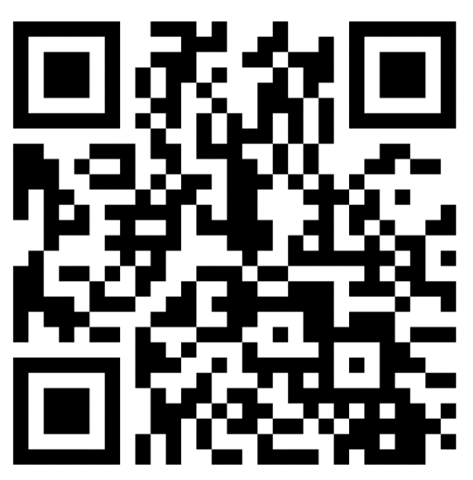
WHAT IS AN INTERNSHIP FOR YOU? Tell us in 3 words!

Slide 4
WHAT IS AN INTERNSHIP FOR THOSE WHO DID IT?

Slide 5
WHAT IS AN INTERNSHIP, REALLY?
It’s an on-the-job experience, outside the university context!
It allows you to «put into practice» theoretical knowledge acquired studying
It is a practical training experience, always supported by a professional: IT’S NOT A JOB CONTRACT!
It allows you to «try» doing a job, to understand if it is what you want to do in the future
It allows you to enrich your curriculum vitae before the graduation, making it unique from that of your fellow students

Slide 6
WHAT TO EXPECT FROM THE HOST ORGANISATION?
Training and support
Rules application

Slide 7
WHICH ARE THE BASIC RULES OF EVERY INTERNSHIP?
WHO | TYPE | LENGHT | STARTING WHEN | BENEFIT | MANAGED BY
STUDENT (Bachelor and Master, Specializing Masters, PhD) | Compulsory (gives you university credit – ECTS) | Depends on your study plan | Depends on your study plan | Paid or unpaid | “SAT”
 | Non compulsory (no university credit) | 1-12 months | Whenever you are ready/available | Paid or unpaid | CAREER SERVICE
GRADUATE (Bachelor and Master, Specializing Masters, PhD) | Extracurricular / Post graduate | 2-12 months | Whenever | Paid (Italy) or unpaid (Abroad) | CAREER SERVICE
 | Professional | 900 hours | Whenever | Paid (Italy) | BOARD OF ARCHITECTS

Slide 8
PC, programs and internet connection are the host organisation’s duty; it is partially an exception the smart working internship
Insurance coverage for accidents and civil liability, on the intern’s activity, are PoliMi’s duty
For the host organisation and PoliMi
Hours and days of attendance must be respected: no overtime, no activity during the night or in the weekend.
The host organisation must provide you each necessaary specialist training course.

Slide 9
Follow the instructions by the supervisor
Follow the host organisation’s internal rules and purposes
Attend according to the agreed schedule, notifying (if possible in advance) any abseces
For the intern
Pay attention to the obligation of secrecy, asking the supervisor if ok to the disclosure (eg. In the thesis/final evaluation)

Slide 10
DID YOU KNOW…?
Intern
Company supervisor

Slide 11
DID YOU KNOW…?
Intern
Academic supervisor!
- You choose him/her when you find the internship
- He/she must approve the internship before starting
- You can ask him/her support for technical or scientific counselling and any problem with the Company
- He/she will validate your ECTS at the end of the internship
Company supervisor

Slide 12
7 PRACTICAL TIPS TO LIVE AT BEST THE INTERNSHIP EXPERIENCE
Ask questions!
Observe, listen and take notes
Get to know also colleagues who don’t work directly with you!
Be open to relations with colleagues: build a network!
Be precise! Respect hours and deadlines!
Be flexible!
Be proactive: anticipate the problem/request!

Slide 13
ROAD TO… COMPULSORY INTERNSHIP!
Get to know my study course regulations
Look for
Activate
Carry out
Feedback
Recognition of ECTS

Slide 14
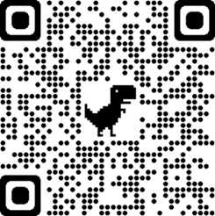
Get to know my study course regulations
When?
Where?
How long?
Which types?

Slide 15
How long?
MASTER OF SCIENCE | ECTS – CREDITS | HOURS
Architecture / Architecture - Built Environment - Interiors | 8 | 200
Building Architecture | 4 | 100
Architecture – Architectural Design / Architecture and Urban Design (MI) | 6 | 150
Urban Planning and Policy Design (MI) | 4 | 100
Architectural Design and History (MN) | 6 | 150
Sustainable Architecture and Landscape Design (PC) | 8 | 200
Building Engineering (MI) | 3 | 75
Building and Architectural Engineering (MI, LC) | 3 | 75
Management of Built Environment | 3 | 75
Landscape Architecture, Land Landscape Heritage (MI) | 4 | 100
SINGLE-CYCLE DEGREE – 5 years | ECTS – CREDITS | HOURS
Ingegneria Edile Architettura | 3 | 75
When?
1° year or 2° year
BUT
On condition that you have inserted it in the study plan, though it is not approved yet.
N.B:
To be completed and credited no later than the dead line given to close your study plan, according to your graduation session
The experience must be continuous

Slide 16
Which types?
Internship in a company
Internal Practical Activity
Workshop
Alternative: Work experience
Where?
In a Company
Pubblic/Research Organisation/Institution
In a Professional Firm
Provided an expert professional supports you.
In Italy or Abroad

Slide 17
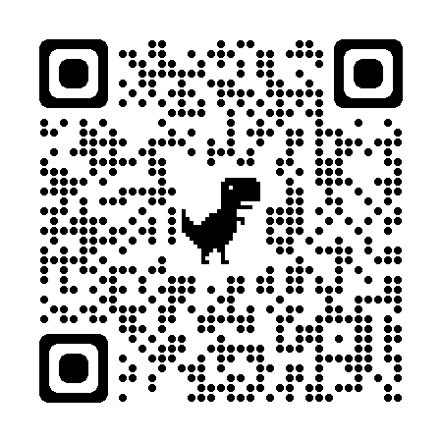
During the transient phase post COVID-19 health emergency, internships can be carried out:
in a mix of distance and presence mode (Supplementary Agreement)
in presence only
You can find Politecnico di Milano guidelines on internships with regards to COVID-19 emergency on the Career Service website

Slide 18
Look for
How in advance?
With which tools?
With which educational goals?
Through which channels?

Slide 19
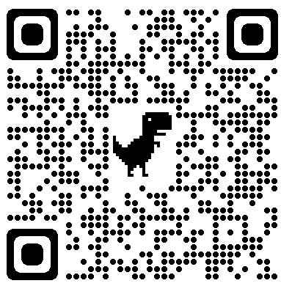
How in advance?
Send applications
Do interviews
Prepare CV and portfolio
2 months

Slide 20
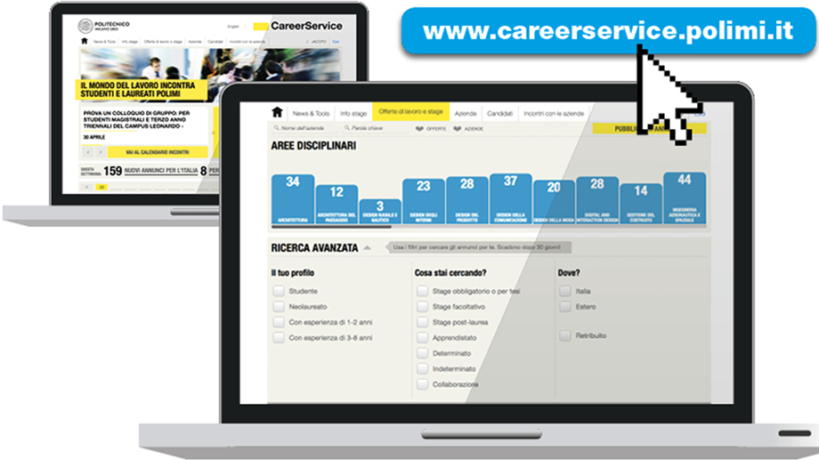
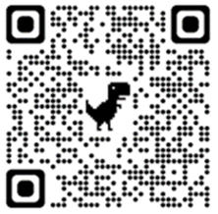
Through which tools?

Slide 21
Through which tools?
Discovering registered Companies for my subject area
Direct contacts (acquaitances, Alumni) or professors
Applying to the online offers on the Career Service website with my CV and portfolio using the correct filters according to internship type and subject area

Slide 22
WHICH INTERNSHIP PROPOSALS CAN YOU FIND?

Slide 23
Activate
In how long?
With which documents?
Why?
Through which channels?

Slide 24
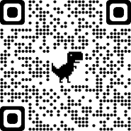
In how long?
5 DAYS
10 DAYS
HOST ORGANISATION WITHOUT INTERNSHIP AGREEMENT
HOST ORGANISATION WITH INTERNSHIP AGREEMENT

Slide 25
With which documents?
Every internship in Italy must be activated through 2 documents:
INTERNSHIP AGREEMENT
INTERNSHIP DOCUMENT
Both documents must be provided and signed before the starting of the internship.
Why?
It’s not PoliMi that decides to use those documents for the activation of your internship, but PoliMi applies national law on internships.

Slide 26
WHAT CHANGES IN CASE OF INTERNSHIP ABROAD?
3 OPTIONS
NOTHING! Just the name of the documents and the language!
The host organisation can follow the same online procedure on the English version of the Career Service → preferable, faster - approximately 10 working days - and not subject to negotiation
The host organization has to:
• register (if not already)
• request and send back signed via email an Internship Agreement
• fill out and send back signed via e-mail an Internship Document

Slide 27
The host organization can ask you to sign a tripartite internship contract based (between the intern, the host organization and PoliMi) on local legislation in place of or in addition to PoliMi standard documents.
In this case you need to consider that your internship might not start before 30/45 days, because before countersigning the contract the Career Service must verify that it respects the University policy and the attention points of the University, especially on articles concerning confidentiality and intellectual property.
THEREFORE communicate to the host organisation that you cannot start the internship immediately and don’t book travel tickets and/or don’t stipulate rent agreements until the signature of the contract between all the necessary parties
The Career Service does not guarantee to reach an agreement in case of need to negotiate the text

Slide 28
3) The host organisation can propose you a bipartite internship contract (between the intern and the host organization) according to the local regulations.
In this case the Career Service must receive a copy of the contract before the start of the internship to track the insurance coverage

Slide 29
For the intern
Travel formalities
Travel and accommodation costs
Passaport/Visa/Stay Permit
Health insurance

Slide 30
Would you like to do a financed internship?
Apply to the Erasmus+ for Traineeship!
The new call for 2024/2025 will open in the next months.
Be ready around mid-April and take part to the preparation events!

Slide 31
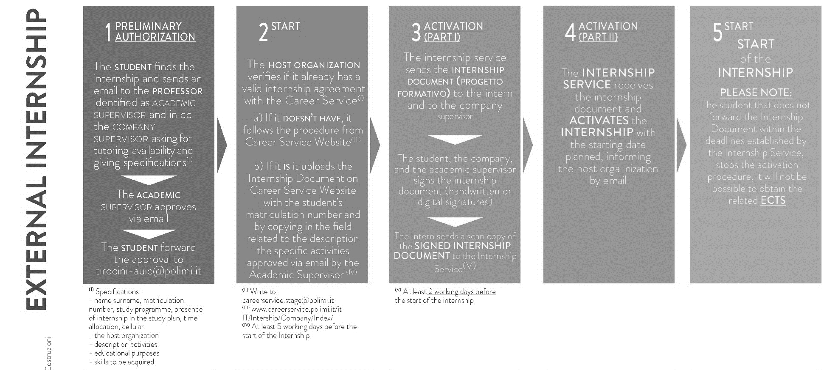
Email address of reference for Mantova Campus: tirocini-mantova@polimi.it
Email address of reference for Piacenza Campus: tirocini-piacenza@polimi.it
Email address of reference for Lecco Campus: stage-lecco@polimi.it

Slide 32
WARNING!
If you start an internship without the requested documents or before all administrative procedures are fullfilled:
You are doing a non-regular activity according to employment laws
You won’t be covered by the insurance
The internship hours done wont’ be considered valid
The internship cannot be back dated
You won’t receive ECTS for the internship nor regularly activated

Slide 33
Email address of reference for Mantova Campus: tirocini-mantova@polimi.it
Email address of reference for Piacenza Campus: tirocini-piacenza@polimi.it
Email address of reference for Lecco Campus: stage-lecco@polimi.it

Slide 34
Work experience comparable to internship (exception and only during the current academic career)
The student sends to Internship Service 1) Copy of the agreed contract: verify that on the contract are shown (or alternatively will provide them in attached): name and type of company, sector of activity, number of employees, location, name and email address of a business contact, period of activity, description of activities and tasks. 2) Final Report of comparable activity completed in all points; the specific form is available in the dedicated pages of websites of single location
If the SAT Manager approves, ECTS will be validated
The Internship Service will request the approval of the proposed activity to the SAT Manager

Slide 35
Changes to the internship (to be communicated at least 2 days in advance)
Business trips
Extension
Interruption
Suspensions (and postponement)

Slide 36
Recognition of the ECTS
In how long?
With which documents?
Through which procedures?

Slide 37
With which documents?
Simply by filling out a final internship survey! You receive a link by email on the internship’s last day!
One for you and one for the company supervisor.
Pay attention to the question that asks you to fill out a technical report on the activities done!
You cannot fill out again the technical report and the survey, once done!
Through which procedures?
Only after you and the company supervisor fill out the survey, then the academic supervisor is notified and can check both surveys (especially the technical report) and evaluate the recognition of the ECTS.

Slide 38
In how long?
Considering the time to fill out the survey and that of the evaluation from the academic supervisor, we advise you to end the internship at least 1 week before the supposed dead line given to close your study plan, to register for the graduation.

Slide 39
WHO DOES WHAT?
SCHOOL’S INTERNSHIP SERVICE («SAT»)
CAREER SERVICE
Helps you looking for the internship
Sets compulsory internship regulations, activates and manages it

Slide 40
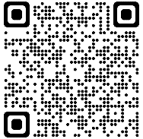
CONTACTS
SCHOOL’S INTERNSHIP SERVICE («SAT»)
CAREER SERVICE

Slide 41
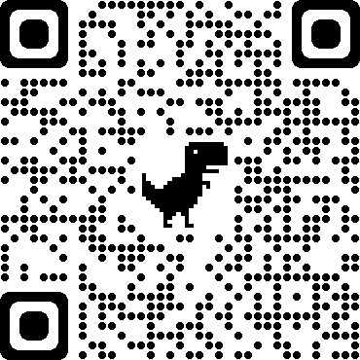
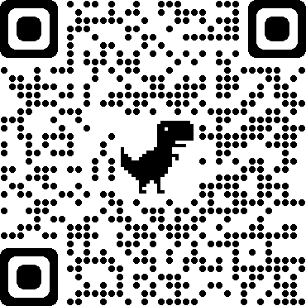
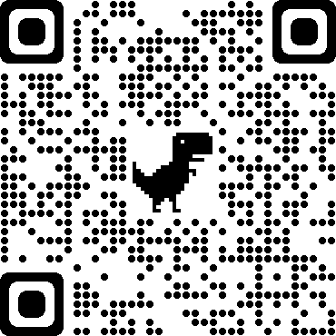
For students of Piacenza Campus: tirocini-piacenza@polimi.it
For students of Mantova Campus: tirocini-mantova@polimi.it
For students of Lecco Campus: stage-lecco@polimi.it

Slide 42
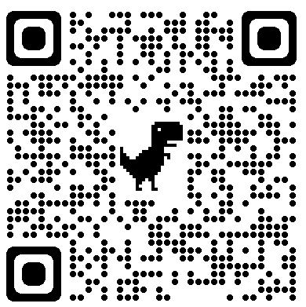
Would you like more info?
Register to MEET YOUR INTERNSHIP ADVISOR, from Tuesday to Friday

Slide 43
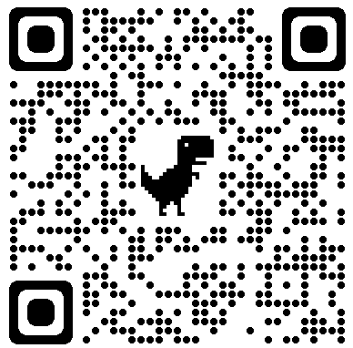
CAREER DAY ARCHITETTURA
11 APRIL

